Slide 1
Polymorphism
Lecturer: Ngo Huy Bien
Software Engineering Department
Faculty of Information Technology
VNUHCM - University of Science
Ho Chi Minh City, Vietnam
nhbien@fit.hcmus.edu.vn

Slide 2

Objectives
To present what is polymorphism.
To override methods and properties.
To create and override virtual methods and properties.
To present why use polymorphism.
To present what is overloading.
To create method and operator overloading.
To present what are early binding and late binding.
To create code with early binding and late binding.

Slide 3

References
Jim Keogh and Mario Giannini. OOP Demystified: A Self-Teaching Guide. 2005.
Tom Archer and Andrew Whitechapel. Inside CSharp. Microsoft Corporation. 2002.
Grady Booch et al. Object Oriented Analysis and Design with Application. 3rd Edition. 2007.

Slide 4
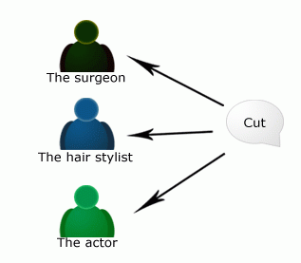

Run-Time Requests
Polymorphism ("many shapes"), an object decides for itself what methods are to be run, so that you can depend on the language to route your requests correctly.

Slide 5
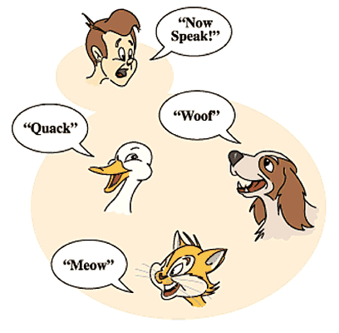
Polymorphism [1, 3]
Polymorphism technically means that one thing has the ability to take many shapes.
Polymorphism in programming terms means that the name of a method can have many behaviors.
Polymorphism is a concept in type theory wherein a name may denote instances of many different classes as long as they are related by some common super-class.
Open
Doors
Windows
Minds
Hearts
Bank Account
Eyes
Arms

Slide 6
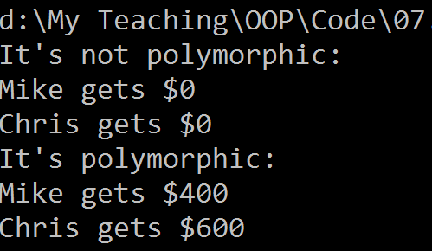
Overriding Methods [1, 2]

Slide 7
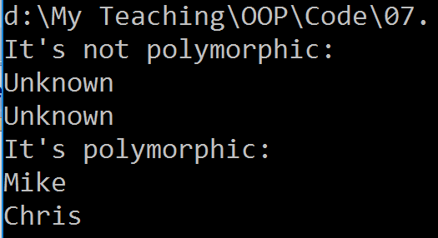
Overriding Properties

Slide 8
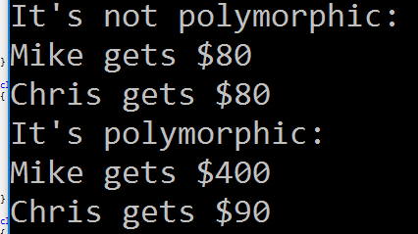
Virtual Methods

Slide 9
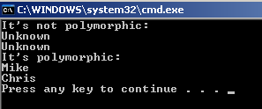
Virtual Properties

Slide 10

Why Use Polymorphism?
Extensibility
Adding new objects/classes to a system without (or with little) change of existing code.

Slide 11
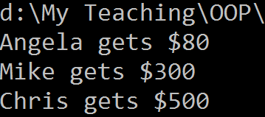
Example

Slide 12


Overloading Methods [3]
Overloading or ad hoc polymorphism: symbols such as + could be defined to mean different things. One may declare functions having the same names, as long as their invocations can be distinguished by their signatures, consisting of the number and types of their arguments.

Slide 13

Operator Overloading [1]

Slide 14

Early Binding
Binding is to associate method name with method definition.
Early binding – binding at compile time. It’s faster than late binding.

Slide 15
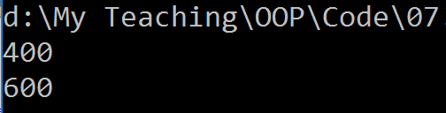
Late Binding
Late binding – binding at run time. It’s slower than early binding.

Slide 16

Thank You for Your Time

